Slide 1
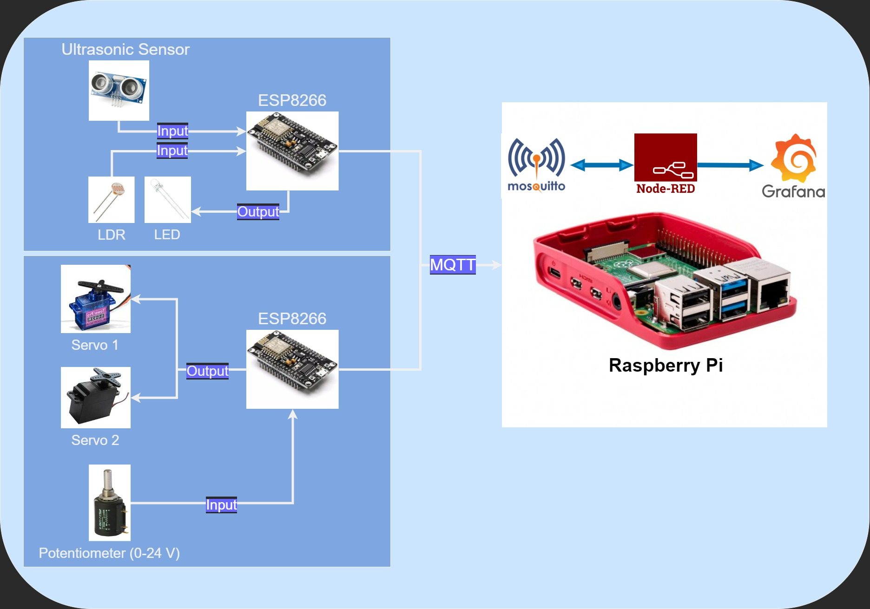
IoT Hardware – Data Pipeline

Slide 2
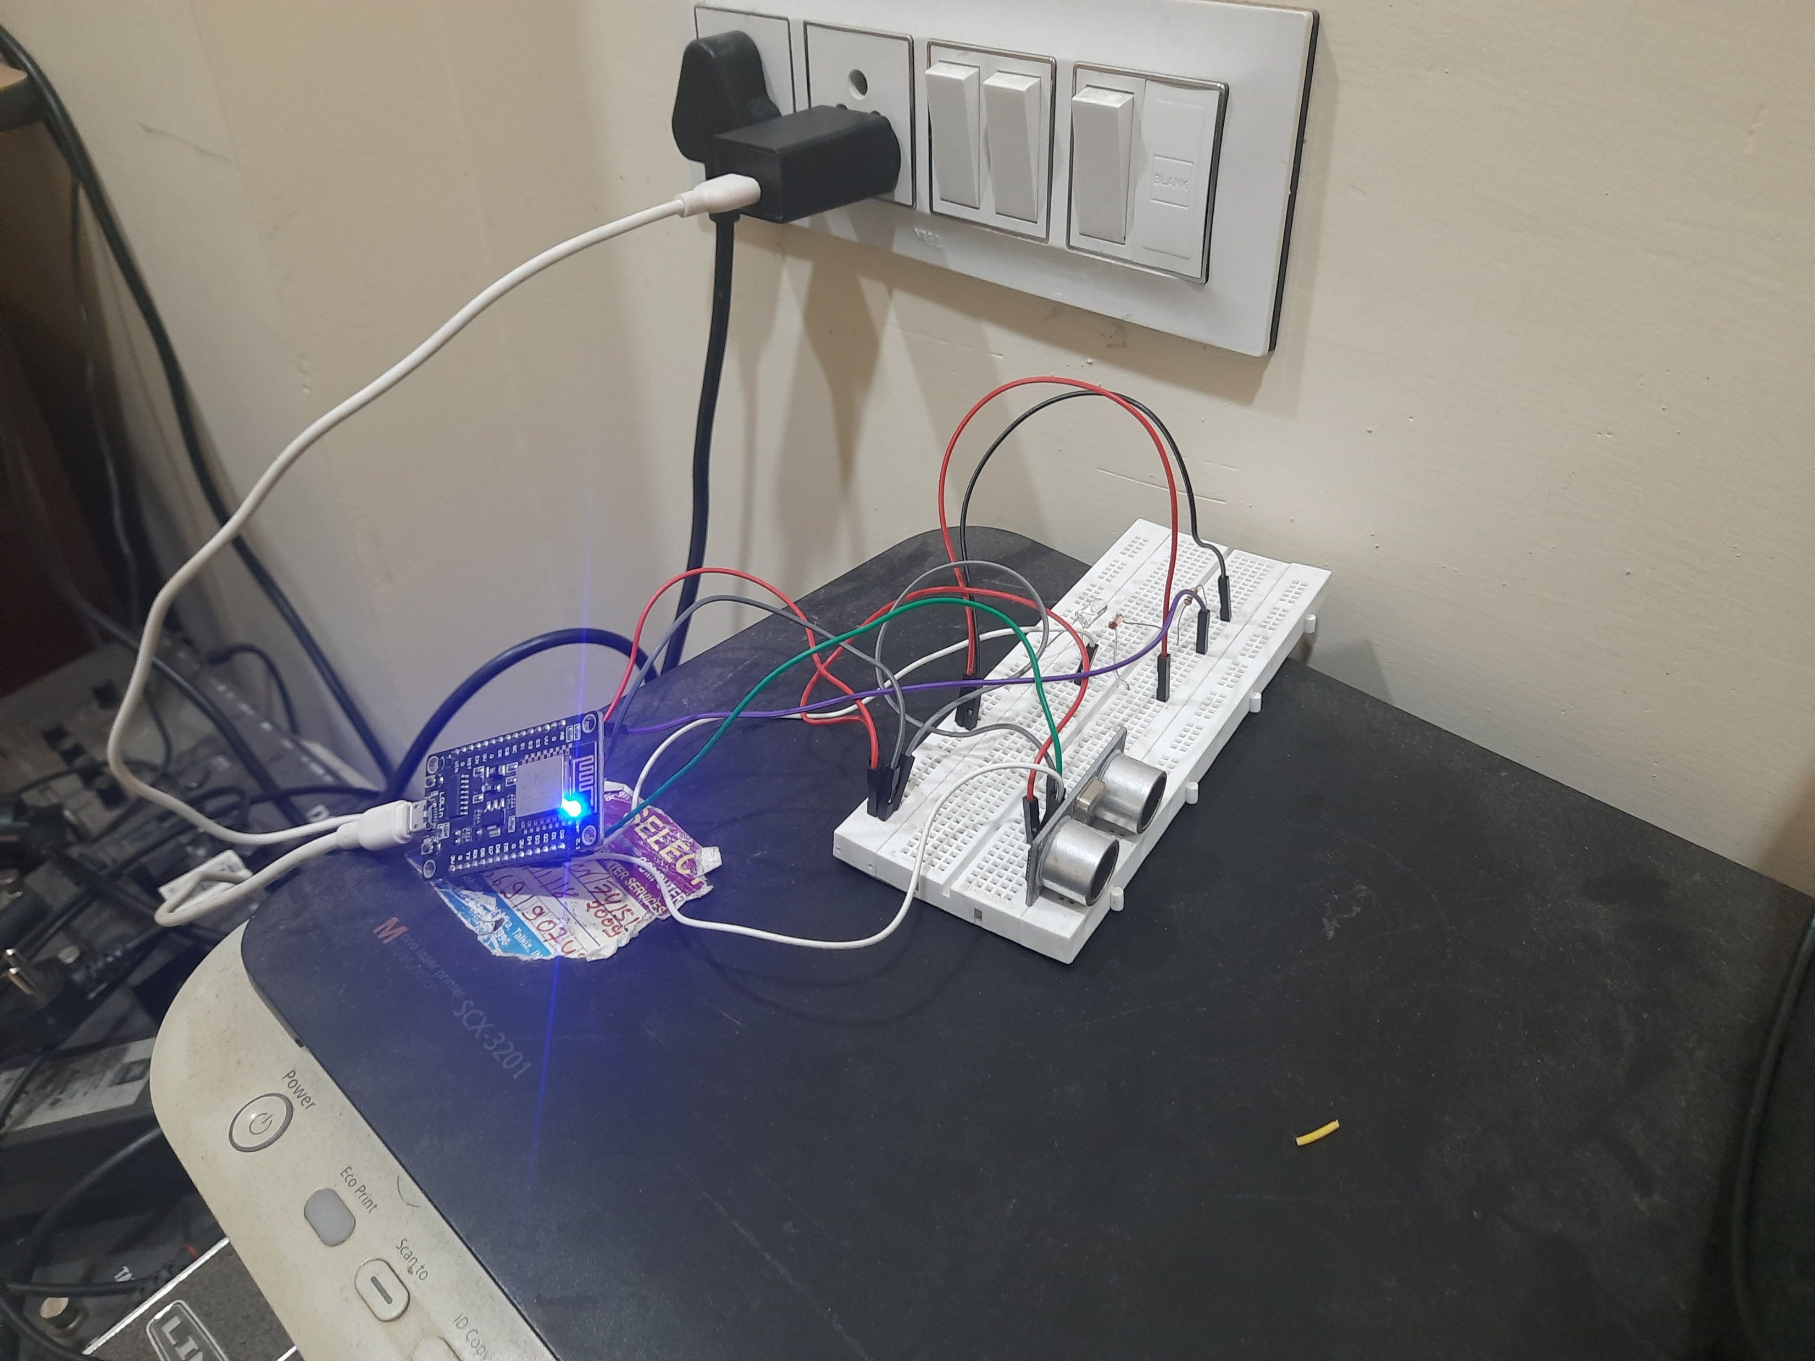
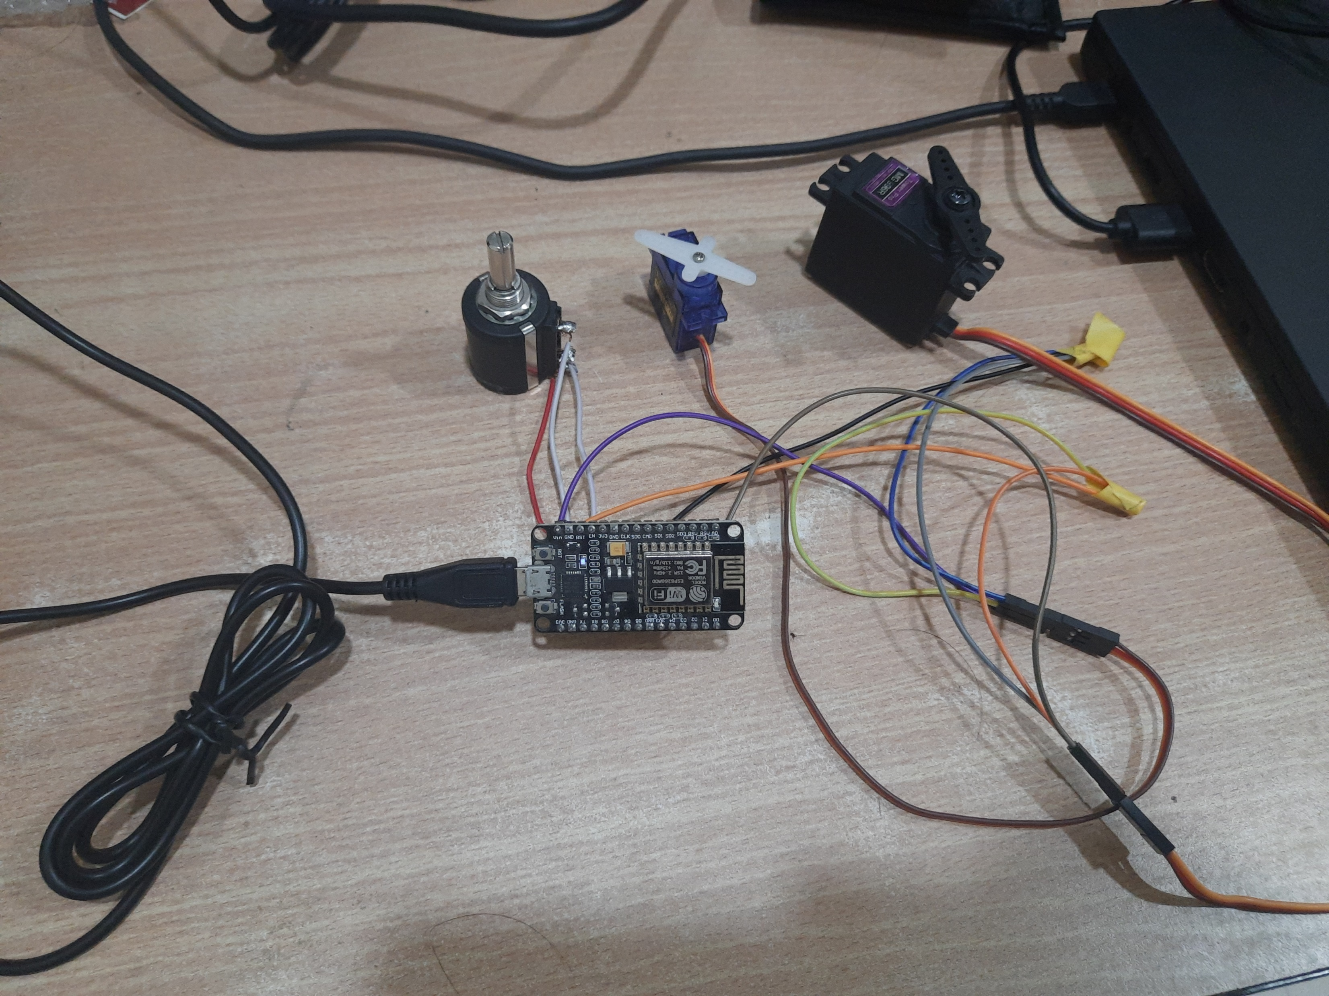
Esp8266 as shown in the Architecture
Esp8266-1
Esp8266-2

Slide 3
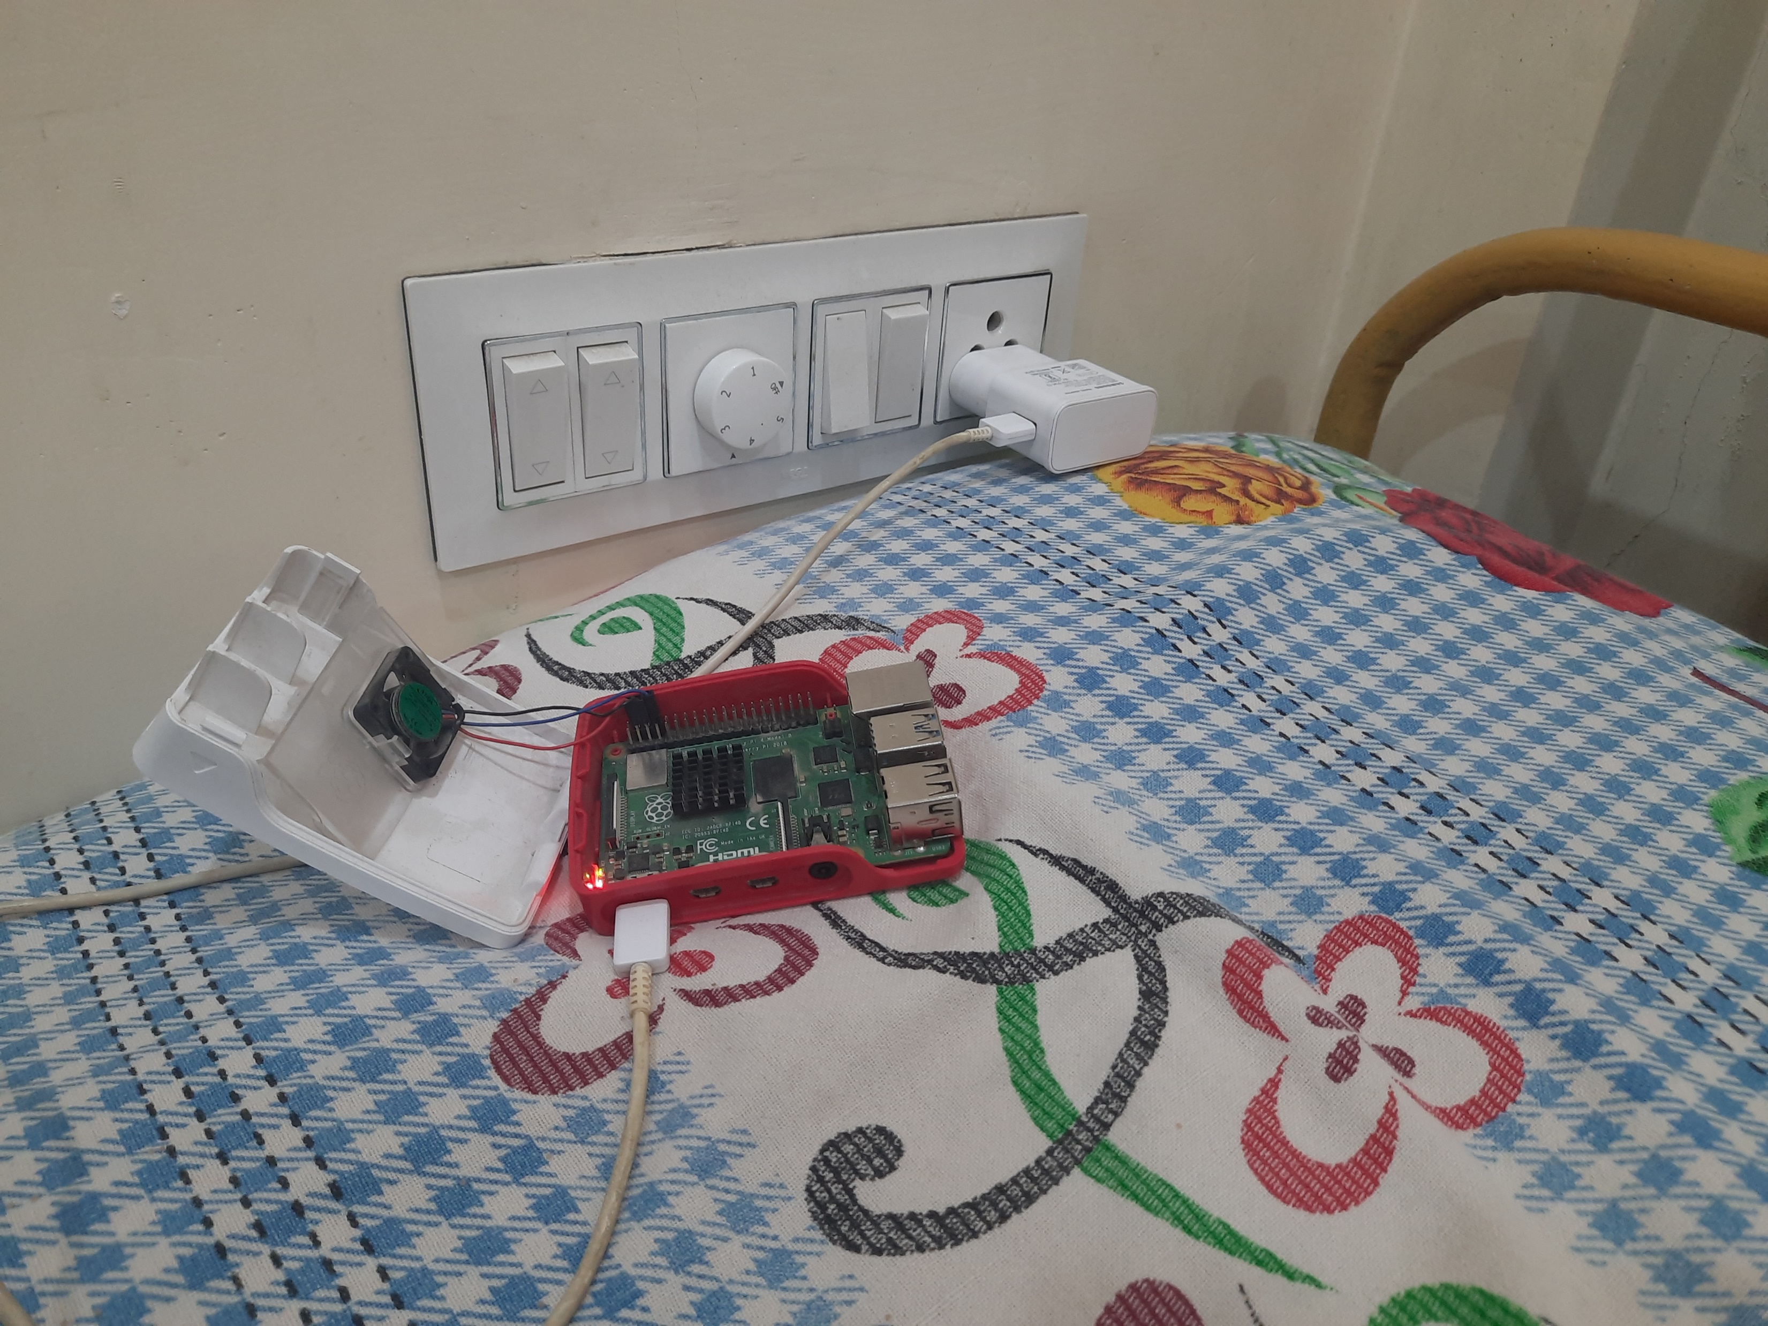
RaspberryPi 4B

Slide 4
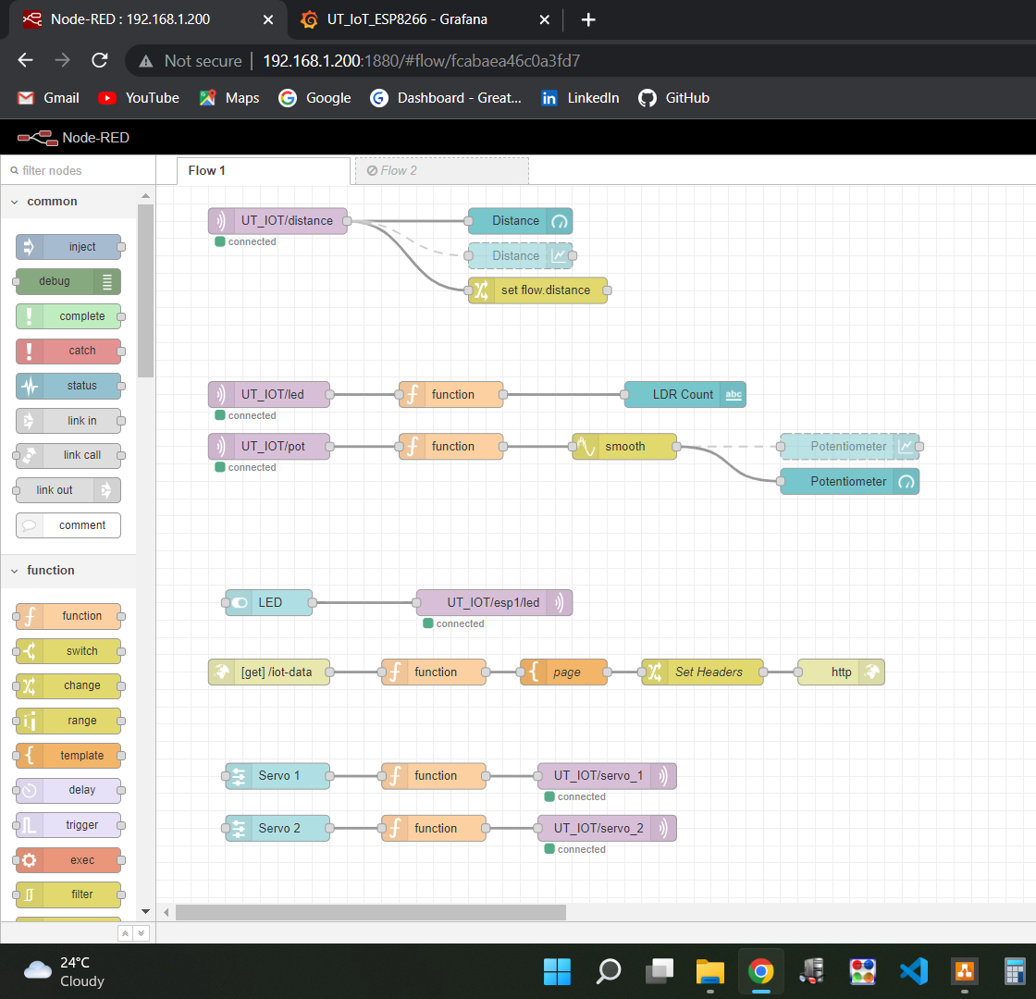
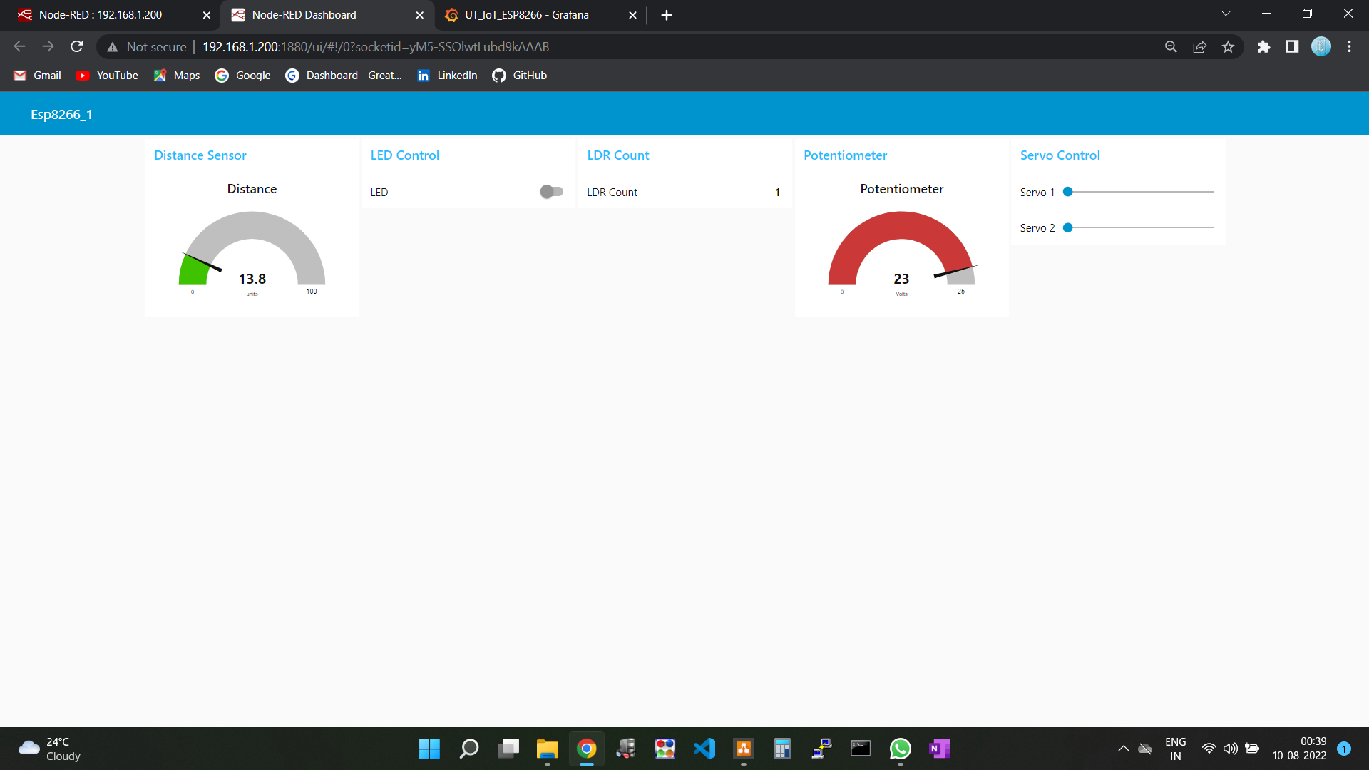
NodeRED Flow and UI/Dashboard

Slide 5
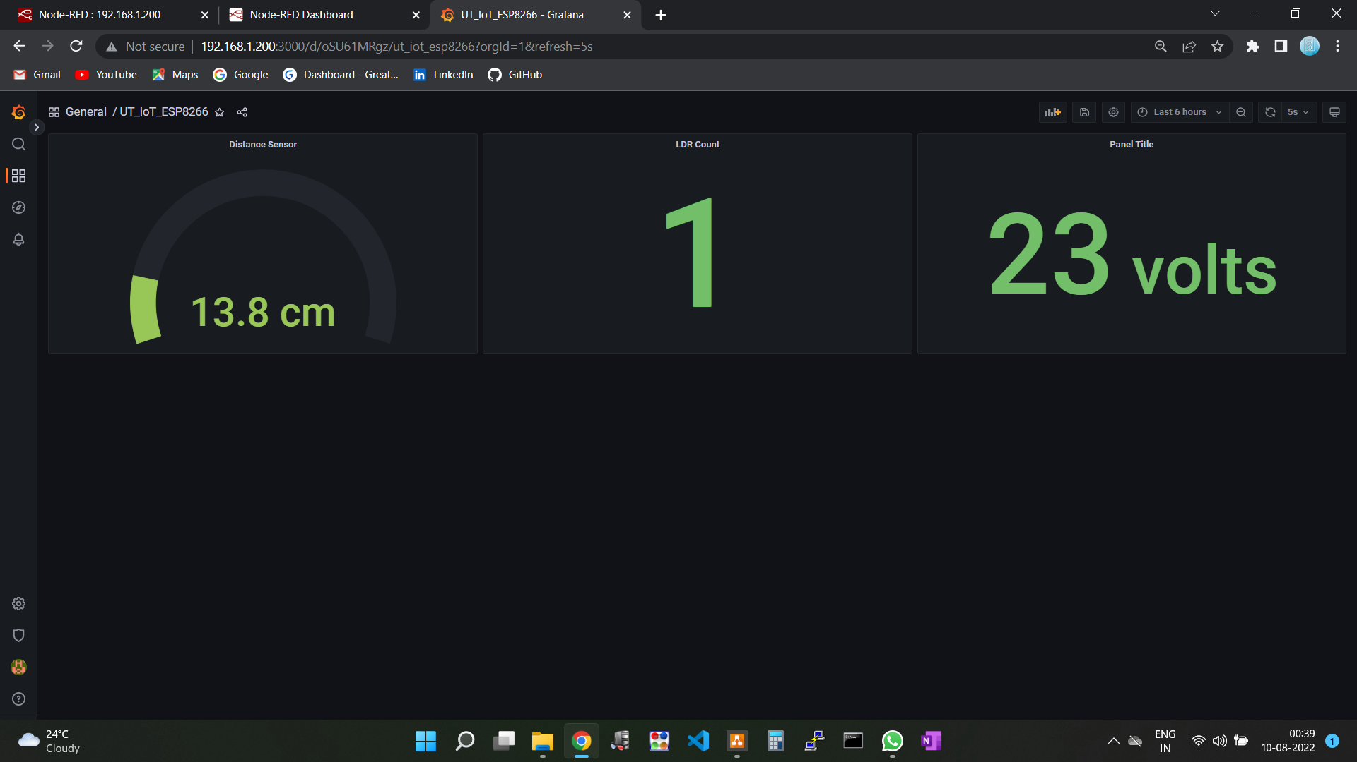
Grafana Dashboard (Using HTTP GET)

